Slide 1
Human Resources Overview
PRESENTED BY:
SHAUNA ASHMORE, ASSISTANT SUPERINTENDENT, HUMAN RESOURCES
MARINA MIHALEVSKY, DIRECTOR, CLASSIFIED HUMAN RESOURCES

Slide 2
ABOUT US
•Recruitment and Staffing
•Selection / Examination
•Classification / Compensation
•Employee Benefits Administration
•Performance Management / Evaluation / Coaching
•Leave Administration
•Employee and Labor Relations
•HR Compliance - Develop policies, procedures and tools to support staff
•Diversity, inclusivity and wellbeing
•Training and Development

Slide 3
HR Governance in K-12 School District
•California Education Code
•Government Code
• Educational Employment Relations Act (EERA)
• Fair Employment and Housing Act (FEHA)
• Fair Labor Standards Act (FLSA)
• Board of Education Policies and Regulations
• Personnel Commission Policies and Regulations
(Merit System/ Civil Service)

Slide 4
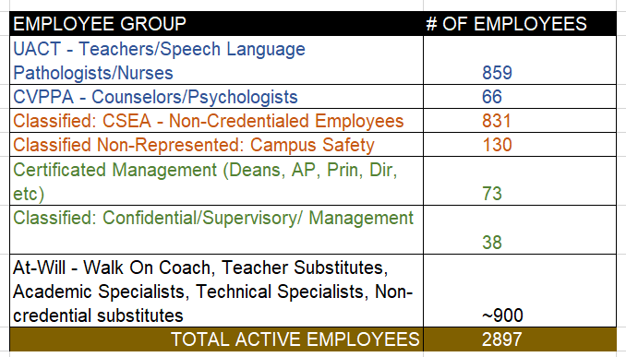
CVUSD EMPLOYEE GROUPS
Source: CVUSD Escape HR/Fiscal Information System

Slide 5
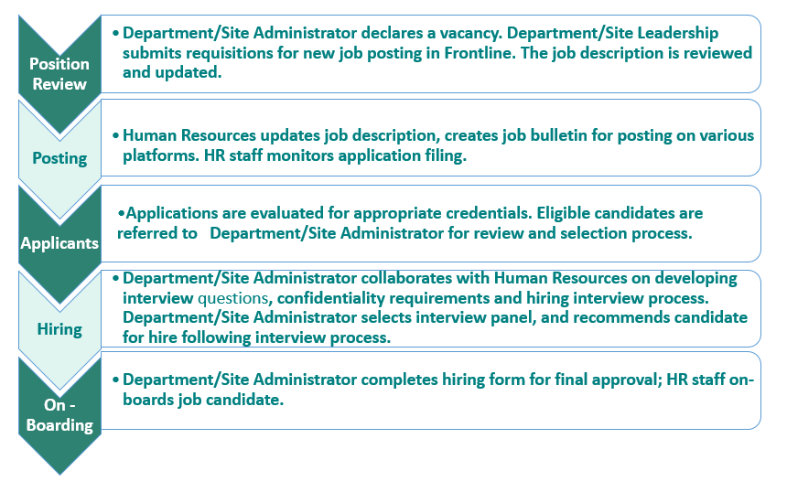
VACANCIES IN CERTIFICATED SERVICE - PROCESS
Notes:
SA - define onboarding - detail steps

Slide 6
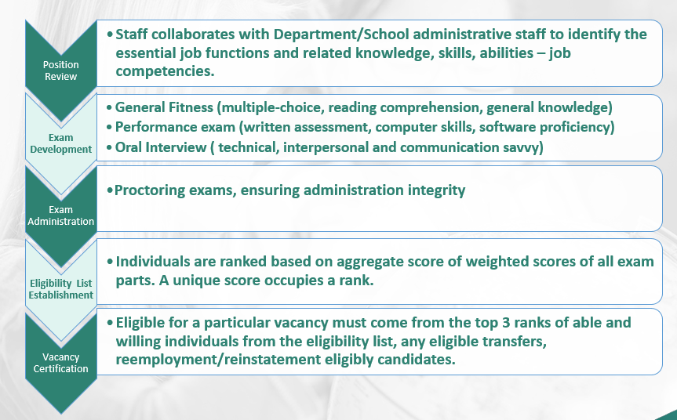
VACANCIES IN CLASSIFIED SERVICE - PROCESS
CVUSD administers the Merit System (Civil Service) under Article 6 of the Education Code in governing classified employment.
The basic tenant of the merit system requires that individuals hired into and promoted within the civil service be selected on the basis of their job-related qualifications and that such selection decisions be free of illegal discrimination and political patronage
Notes:
MM - define onboarding - detail steps

Slide 7
ONBOARDING PROCESSES
CERTIFICATED
CLASSIFIED (NON-CREDENTIALED)
Official transcripts & evidence of active credential(s)
Background - Livescan - CA Department of Justice / FBI
TB Risk Assessment
Mandatory Training - Child Abuse Mandated Reporter & Sexual Harassment
Physical Examination
Work verification forms from previous employers
HR & Payroll Paperwork
Contract
Background - Livescan - CA Department of Justice / FBI
TB Risk Assessment
Mandatory Training - Child Abuse Mandated Reporter
Physical Examination - select job classes with extensive physical demands (Paraeducators, Child Nutrition, Child Care, Custodian, Grounds, Maintenance)
Drug Test - select job classes (safety sensitive)
Authorization to work in US

Slide 8
CURRENT VACANCIES
CERTIFICATED
CLASSIFIED (NON-CREDENTIALED)
Current Recruitments:
https://www.conejousd.org/Page/1608
Speech Language Pathologists
Long-Term Substitute Teacher(s)
Long-Term Substitute Counselor(s)
Ongoing Recruitments:
https://www.schooljobs.com/careers/conejousd
Paraeducator -supply of labor market does not support demand - over 200 part-time positions
Child Care Assistants - part-time late afternoon service need (afterschool)
Child Nutrition Assistants - part-time mid-morning service needs

Slide 9
RECURRING HIRING CHALLENGES
CERTIFICATED
CLASSIFIED (NON-CREDENTIALED)
Registered Nurses
Speech Language Pathologists
Teachers with Special Education Credential(s)
Campus Safety Assistants
Child Care Staff
Child Nutrition Staff
Licensed Vocational Nurses
Special Education Paraeducators

Slide 10
RECRUITMENT APPROACH
CERTIFICATED
CLASSIFIED (NON-CREDENTIALED)
District Website
District Social Media
Edjoin.org - CA
College Job Boards & Career Fairs Indeed.com
Association of California School Administrators (ACSA)
Diversity Recruitment Partners (e.g. Diversity in Education, Professional Diversity Network)
Hispanic/Latino Professional Association (HLPA)
Speech-Language-Hearing Association (CSHA)
Governmentjobs.com - National
Schooljobs.com - National
District Website
Edjoin.org - CA
Indeed.com
College Job Boards - Local
Facebook District

Slide 11
HR PROCESSES AND INITIATIVES
CERTIFICATED
CLASSIFIED (NON-CREDENTIALED)
Review all job descriptions - added diversity, equity, inclusion statement
Post positions to a variety of websites (added statement of DEI)
Begin hiring early in the recruitment window
Site administrator training in diversity, equity and inclusion (began in 2021-2022)
Job Fairs
City of Thousand Oaks, CLU, CSUCI, other CA career fairs, school sites
Equity & Inclusion Training for new hires
Interview Panel Composition
Committee compositions
Review of minimum entrance qualifications across classified service through job specification updates
Blind application screening, if input is sought from department
Immediate supervisors are not permitted to serve on oral panels to establish eligibility list
Supervisory/Management selection process inclusive of questions to assess openness to diversity/inclusion

Slide 12
JOB BULLETINS / APPLICATIONS
The CVUSD Governing Board is committed to providing equal opportunity for all individuals in district programs and activities. District programs, activities, and practices shall be free from unlawful discrimination, including discrimination against an individual or group based on race, color, ancestry, nationality, national origin, immigration status, ethnic group identification, ethnicity, age, religion, marital status, pregnancy, parental status, physical or mental disability, sex, sexual orientation, gender, gender identity gender expression, or genetic information; a perception of one or more of such characteristics; or association with a person or group with one or more of these actual or perceived characteristics. (BP 0410). Any applicant who attempts to directly contact individual Board Members with the intent of influencing the decision of the Board will be considered disqualified from candidacy for this position.

Slide 13
HIRING TRENDS: DEMOGRAPHICS
https://docs.google.com/spreadsheets/d/1H50JGiD5BjRSfZLkUhFESWp0QACxAkNU/edit?usp=sharing&ouid=114883951157982788486&rtpof=true&sd=true

Slide 14
Questions?

